Slide 1
Microsoft Power BI

Slide 2
Power BI (Title)
MVP Name / Presenter Name
Title -
#MVP -

Slide 3
Agenda
Why .NET Core
Authenticating with Microsoft.Identity.Web
Calling the Power BI Service API
Adding Client-side TypeScript Support
Creating a View Model for App Workspaces
Working with Multi-resource Embed Tokens

Slide 4
.NET Core
Decouple from Windows and IIS
Create applications and web APIs in cross-platform manner
Break up System.Web.dll monolith
Applications only load the services they need
Available .NET Core Hosts
Kestrel, IIS, HTTP.sys, Nginx, Apache and Docker

Slide 5
ASP.NET Core MVC
Support for building web UI and web APIs
MVC pattern helps make your web APIs and web apps testable.
Razor Pages provide simple page-based programming model
Razor markup provides syntax for Razor Pages and MVC views.
Tag Helpers enable server-side code to create/render HTML elements
Web APIs have built-in support for content negotiation (e.g. json vs xml)
Model binding maps HTTP requests to parameterized action methods
Model validation automatically performed on client-side and server-side

Slide 6
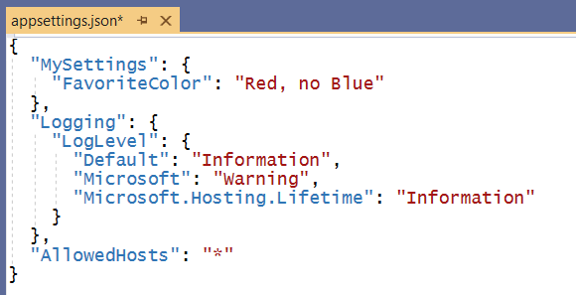
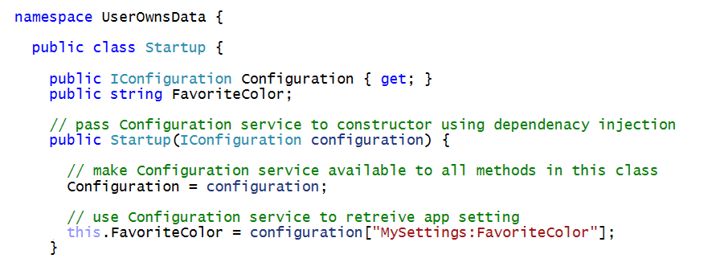
Essential .NET Core Topics
Understanding Dependency injection is import
Services are registered on application start up
Services injected into classes using parameterized constructors

Slide 7
.NET 5.0
What is .NET 5?
Merging of separate platforms into a single platform
.NET Framework
.NET Core
.NET 5.0
Xamarin

Slide 8
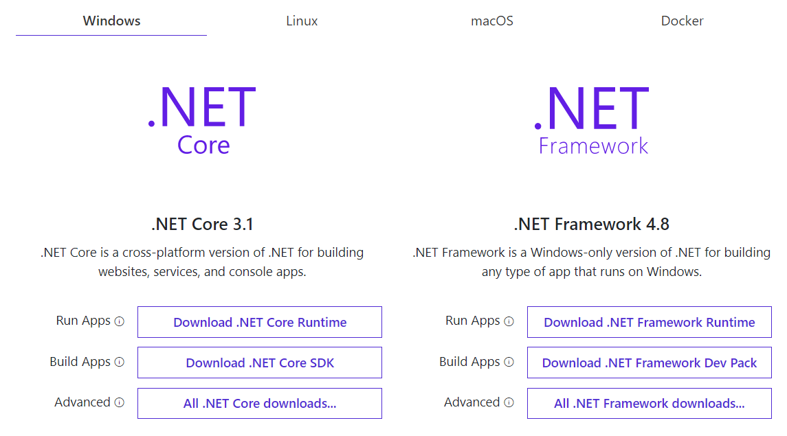
Install .NET Core SDK
https://dotnet.microsoft.com/download

Slide 9
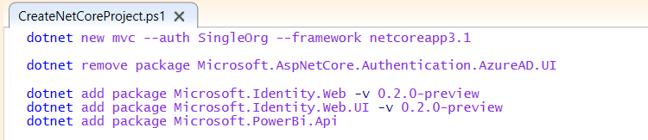
.NET Core CLI
The .NET Core command-line interface (CLI)
Cross-platform toolchain for creating, debugging and publishing applications
Create new applications using dotnet new command
Add NuGet packages using dotnet add package command

Slide 10
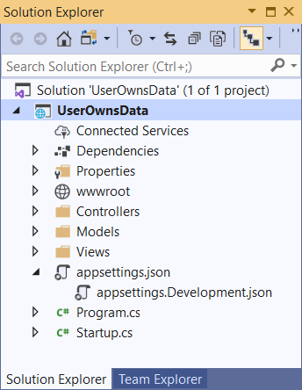
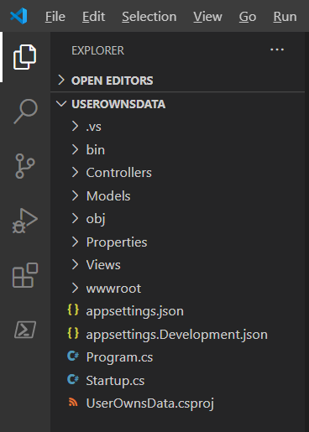
Visual Studio 2019 versus Visual Studio Code
Should you use Visual Studio 2019 versus Visual Studio Code?
Yes, either one can be used to develop for .NET Core 3.1 and .NET 5

Slide 11
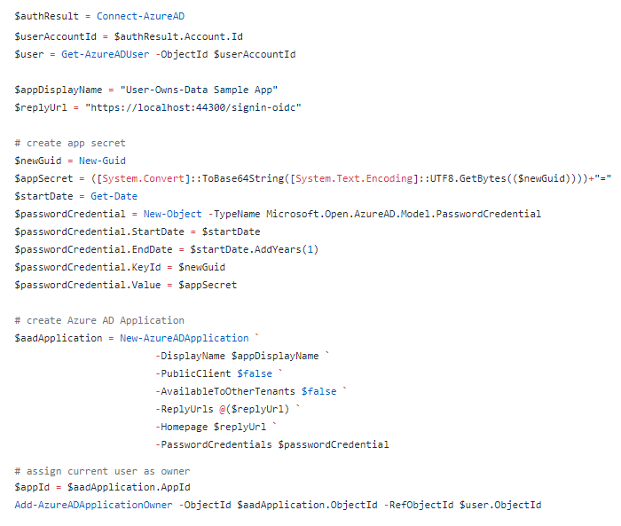
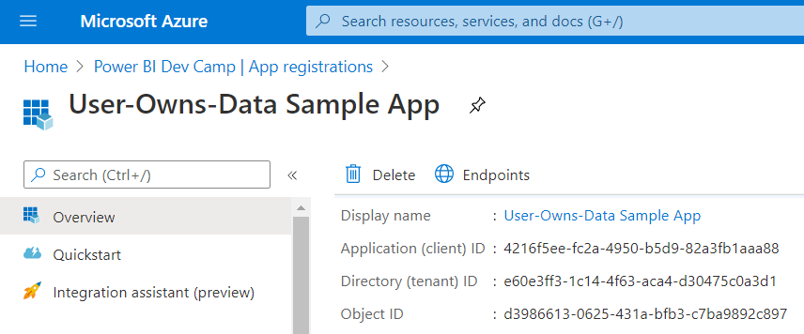
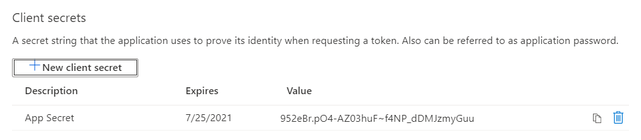
Creating Azure AD Application with PowerShell

Slide 12
Agenda
Why .NET Core?
Authenticating with Microsoft.Identity.Web
Calling the Power BI Service API
Adding Client-side TypeScript Support
Creating a View Model for App Workspaces
Working with Multi-resource Embed Tokens

Slide 13
Introducing Microsoft.Identity.Web
What is Microsoft.Identity.Web
Set of components and classes to assist developers
Used to perform authentication in Web applications and Web APIs
When to use
In Web application and Web APIs built on .NET Core 3.1 and .NET 5
Currently in preview – release schedule synced with .NET 5 (November 2020)

Slide 14
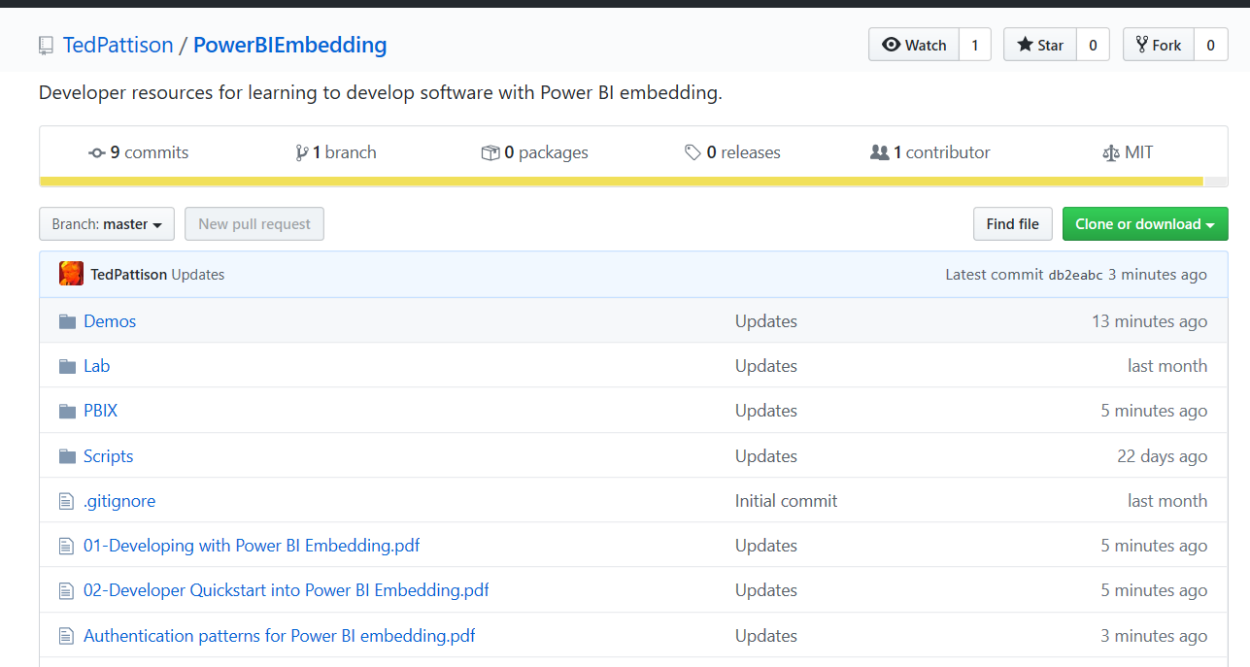
Sample Code and Tutorial
Stored in a GitHub repository for easy download
https://github.com/TedPattison/PowerBIEmbedding

Slide 15
Authenticating with Azure AD
Custom applications must authenticate with Azure AD
Your code implements and authentication flow to obtain access token
Access token must be passed when calling Power BI Service API
Microsoft supports two endpoints for programming authentication
Azure AD V1 endpoint (released to GA over 8 years ago)
Azure AD V2 endpoint (released to GA in May 2019)
Azure Active Directory
Custom App
Access Token
Access Token
Power BI Service

Slide 16

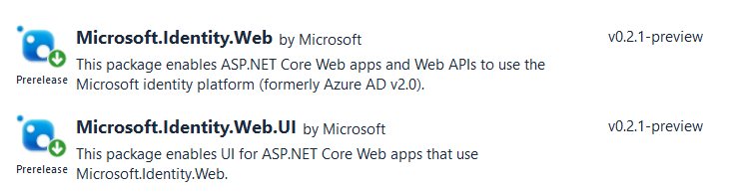
Microsoft Authentication Libraries
xxx

Slide 17
Agenda
Why .NET Core?
Authenticating with Microsoft.Identity.Web
Calling the Power BI Service API
Adding Client-side TypeScript Support
Creating a View Model for App Workspaces
Working with Multi-resource Embed Tokens

Slide 18
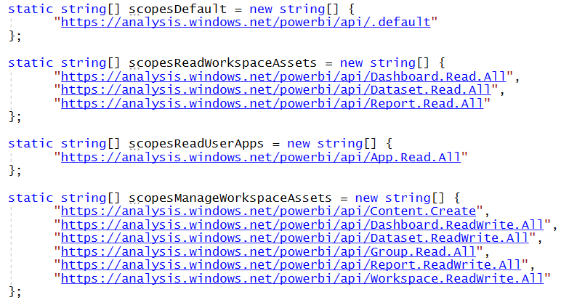
Power BI Service API Scopes
Azure AD V2 endpoint requires passing scopes
Scopes define permissions required in access token
Scopes defined as resource + permission https://analysis.windows.net/powerbi/api/ + Report.ReadWrite.All

Slide 19
Agenda
Why .NET Core?
Authenticating with Microsoft.Identity.Web
Calling the Power BI Service API
Adding Client-side TypeScript Support
Creating a View Model for App Workspaces
Working with Multi-resource Embed Tokens

Slide 20
Agenda
Why .NET Core?
Authenticating with Microsoft.Identity.Web
Calling the Power BI Service API
Adding Client-side TypeScript Support
Creating a View Model for App Workspaces
Working with Multi-resource Embed Tokens

Slide 21
Agenda
Why .NET Core?
Authenticating with Microsoft.Identity.Web
Calling the Power BI Service API
Adding Client-side TypeScript Support
Creating a View Model for App Workspaces
Working with Multi-resource Embed Tokens

Slide 22
Summary
Why .NET Core?
Authenticating with Microsoft.Identity.Web
Calling the Power BI Service API
Adding Client-side TypeScript Support
Creating a View Model for App Workspaces
Working with Multi-resource Embed Tokens

Slide 23
Power BI Embedding – The Big Picture
User launches your app using a browser
App authenticates with Azure Active Directory and obtains access token
App uses access token to call to Power BI Service API
App retrieves data for embedded resource and passes it to browser.
Client-side code uses Power BI JavaScript API to create embedded resource
Embedded resource session created between browser and Power BI service
5
Power BI Service
Browser
iFrame
6
4
4
3
1
Your App
2
Azure AD

Slide 24
Choosing the Correct Embedding Model
User-Owns-Data Embedding
All users require a Power BI license
Useful in corporate environments
App authenticates as current user
Your code runs with user’s permissions
User’s access token passed to browser
App-Owns-Data Embedding
No users require Power BI license
Useful in commercial applications
App authenticates with app-only identity
Your code runs with admin permissions
Embed token passed to browser
User-Owns-Data Embedding for use within Organization
App-Owns-Data Embedding for use by ISVs
Browser
Power BI Service
Browser
Power BI Service
iFrame
iFrame
Azure AD
Access Token
Power BI
Embed Token

Slide 25
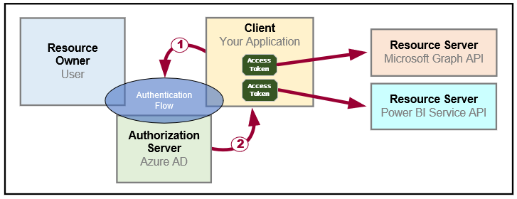
OAuth 2.0 Fundamentals
Client application calls to resource server on behalf of a user
Client application implements authentication flow to acquire access token
Access token contains permission grants for client to call resource server
Client passes access token in Authorization request header when calling to resource server
Resource server inspects access token to ensure client application has proper permissions

Slide 26
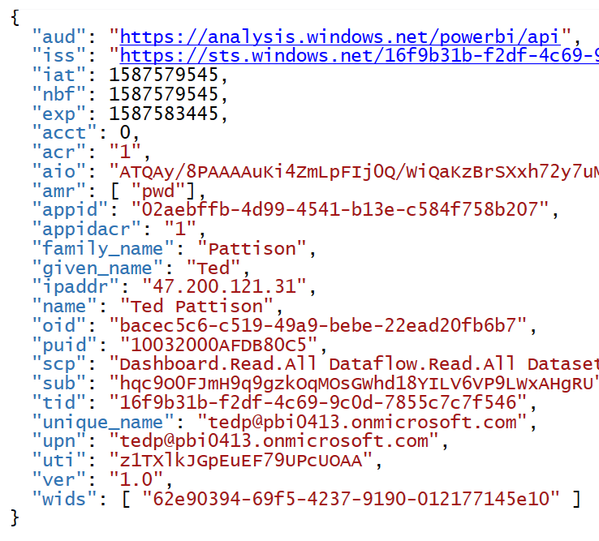
Access Tokens
Access token is a bearer token
Access token can be used by anyone who bears it (e.g. steals it)
Access tokens should always be passed over HTTPS using TLS
Access token expires after an hour
There are two types of access token
User tokens
App-only tokens

Slide 27
Refresh Tokens
Access tokens expiration after an hour
How do you get new access tokens without requiring the user to sign in?
Refresh tokens used to manage access token expiration
Authorization server passes refresh tokens to client application along with access token
Refresh token has lifetime of 14 days by default (90 days max)
Refresh token acts as a credential used to obtain new access token without user interaction
Refresh tokens often cached in browser storage or in backend database

Slide 28
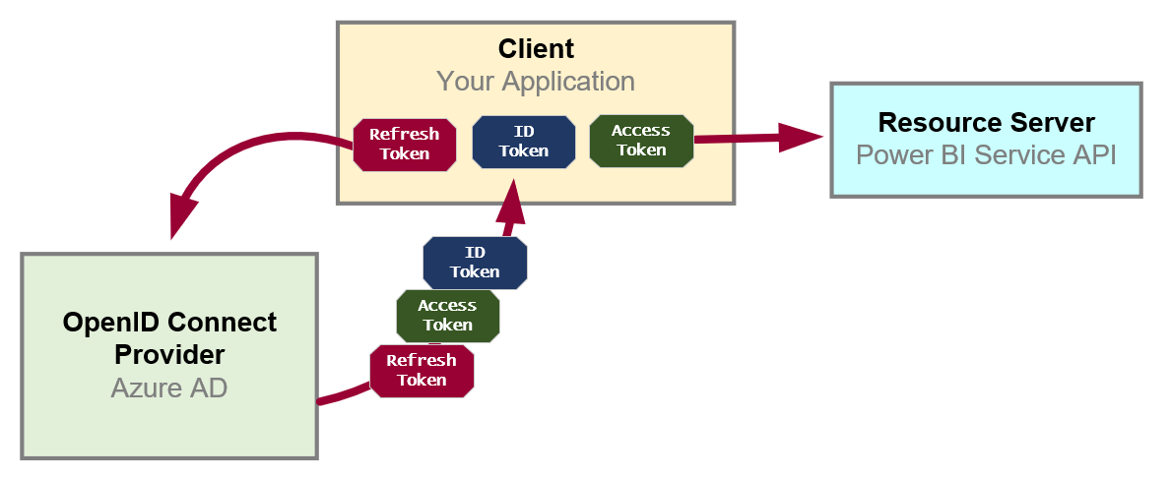
Open ID Connect and ID Tokens
OAuth 2.0 has shortcomings with authentication & identity
It does not provide client with means to validate access tokens
Lack of validation makes client vulnerable to token forgery attacks
Open ID Connect is standard which extends OAuth 2.0
OpenID Connect provider passes ID token in addition to OAuth 2.0 tokens
OpenID Connect provider provides client with keys for token validation

Slide 29
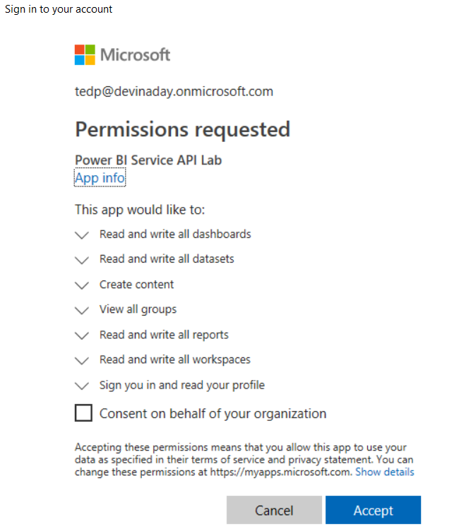
Delegated Permissions and Scopes
Client application requires delegated permissions
Client application needs delegated permissions to make API calls on behalf of user
But first, user must consent to delegated permissions requested by client application
Client application indicates what permissions it needs using scopes parameter
Each delegated permission has ID known as scope
Scope name usually begins with name of hosting resource
Resource ID for the Power BI Service API
https://analysis.windows.net/powerbi/api
Examples of scopes supported by the Power BI Service API
https://analysis.windows.net/powerbi/api/Dashboard.Read.All
https://analysis.windows.net/powerbi/api/Dataset.Read.All
https://analysis.windows.net/powerbi/api/Report.Read.All

Slide 30
Public Clients versus Confidential Web Clients
OAuth 2.0 defines two different types of client applications
Public clients
Confidential web clients
Public clients used for desktop and native applications
Cannot keep a secret - entire application is deployed to client device
Does not run from verifiable endpoint on the Internet
Confidential web clients used for web applications and service
Web application can track application secret on server-side with code or configuration
Runs from verifiable endpoint on the Internet

Slide 31
OAuth 2.0 Client Registration
Client must be registered with authorization server
Authorization server tracks each client application with unique Client ID
Client can be configured with Reply URLs (aka redirect URI)
Reply URL used to transmit security tokens to clients
Client registration can track other attributes (e.g. credentials & default permissions)

Slide 32
Authentication Flows
Public/native clients
Interactive Flow
Used in public clients to obtain access token interactively
User Password Credential Flow
Used in Native clients to obtain access code
Requires passing user name and password across network
Confidential Web clients
Client Credentials Flow
Authentication based on password or certificate held by application
Used to obtain app-only access tokens
Implicit Flow
Used in SPAs built with JavaScript and AngularJS
Application obtains access token w/o acquiring authorization code
Authorization Code Flow
Client first obtains authorization code sent back to browser
Client then obtains access token in server-to-server call

Slide 33
Agenda
OAuth 2.0 and OpenID Connect
Microsoft Identity Platform 2.0
Developing with the Power BI .NET SDK
Developing with the App-Owns-Data Model
Developing Single Page Applications (SPAs)
Developing Secure Web Applications

Slide 34
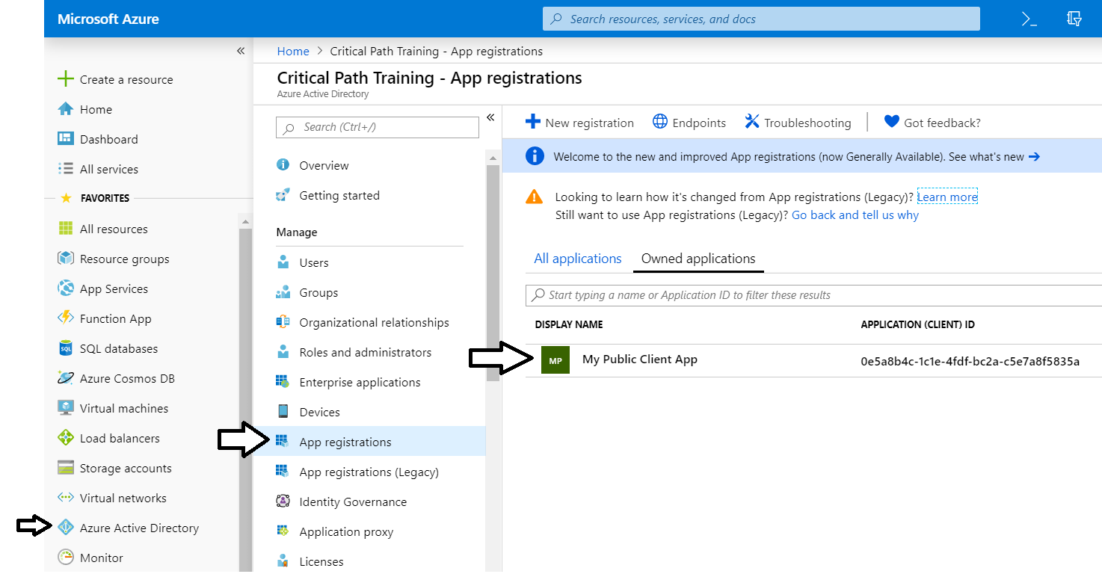
The Azure Portal
Azure portal allows you to register Azure AD applications
Azure Portal accessible at https://portal.azure.com
No Azure subscription required to register applications

Slide 35
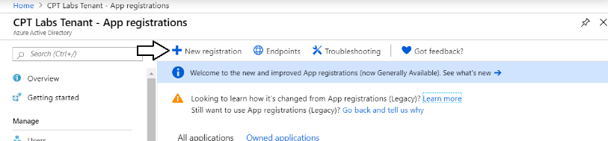
Azure AD Applications
Creating applications required for AAU authentication
Applications are created as Public client applications or Web Applications
Application identified using GUID known as application ID
Application ID often referred to as client ID or app ID

Slide 36
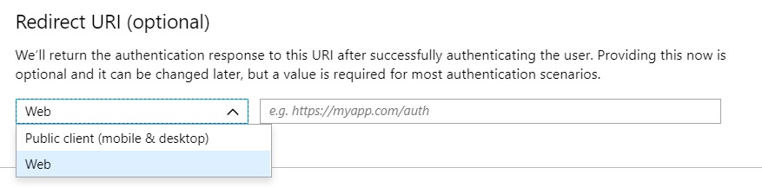
Azure AD Application Types
Public client (mobile and desktop)
Used to register public/native clients
Web
Used to register confidential web clients

Slide 37
Azure AD Applications versus Service Principals
Azure AD creates service principal(s) for each application
Service principal created once per tenant
Service principal acts as first-class AAD security principal
Host Tenant
Tenant 2
Tenant 3
Application
Application ID
Service Principal
Object ID
Service Principal
Object ID
Service Principal
Object ID
Permission Grants
User1
User2
Permission Grants
User1
User2
Permission Grants
User1
User2

Slide 38
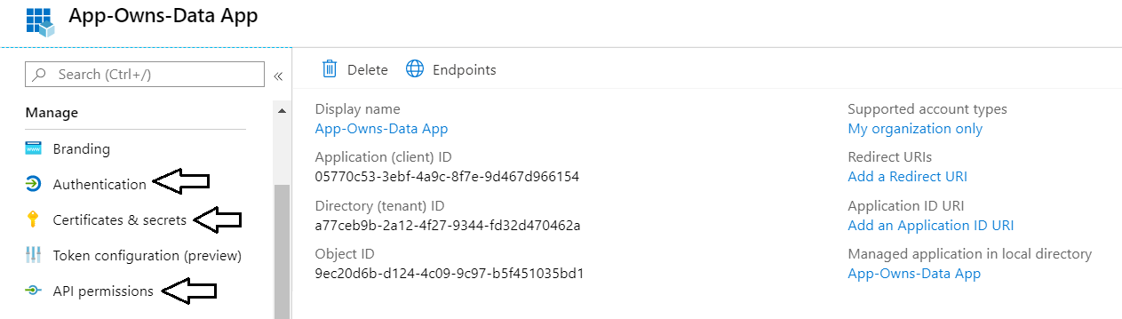
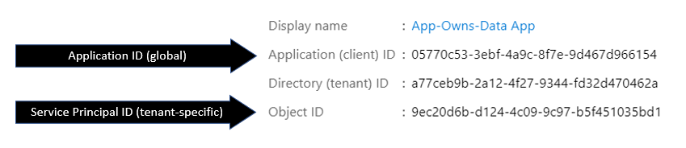
Configuring Azure AD Applications
Azure Portal provides UI to create and configure applications
New application generated with Application ID and Object ID

Slide 39
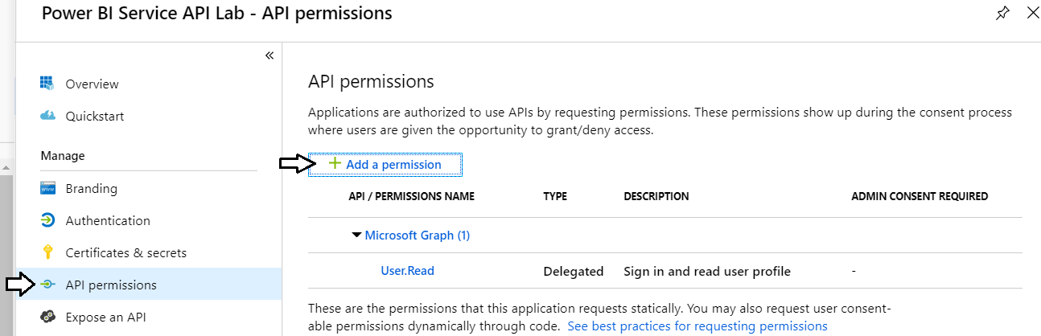
Configuring Required Permissions
Application configured with permissions
Default permissions allows user authentication – but that's it
To use APIs, you can assign permissions to the application
This was required when using Azure AD v1 endpoint and ADAL
This is now optional when using Azure AD v2 endpoint and MSAL

Slide 40
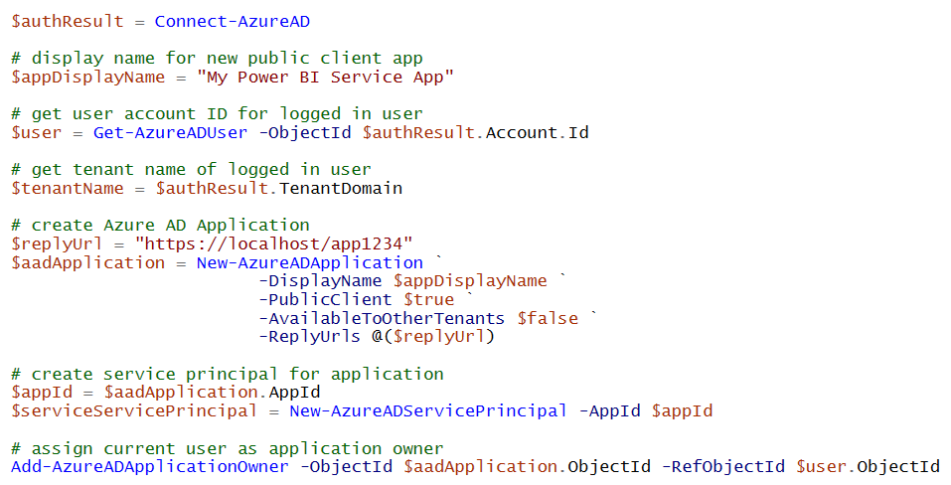
Registering Azure AD Apps with PowerShell

Slide 41
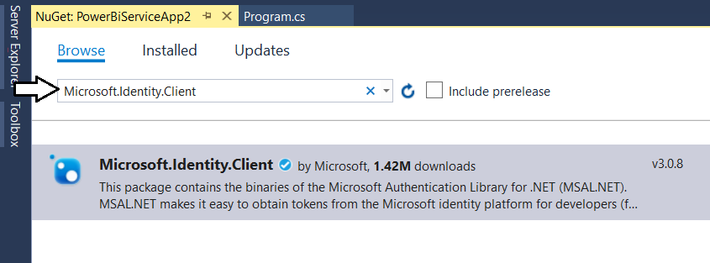
Microsoft Authentication Library (MSAL .NET)
Developing with the Microsoft Authentication Library for .NET
Provides assistance implementing authentication flows with Azure AD v2 Endpoint
Added to project as Microsoft.Identity.Client NuGet package
Provides different builder classes for public clients vs confidential web clients
Provides built-in support for token caching and silent token acquisition

Slide 42
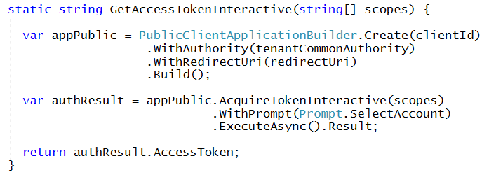
Interactive Access Token Acquisition
Flow implemented using PublicClientApplication object
Created using PublicClientApplicationBuilder object
Requires passing redirect URI that matches redirect URI that is registered
You can control prompting behavior

Slide 43
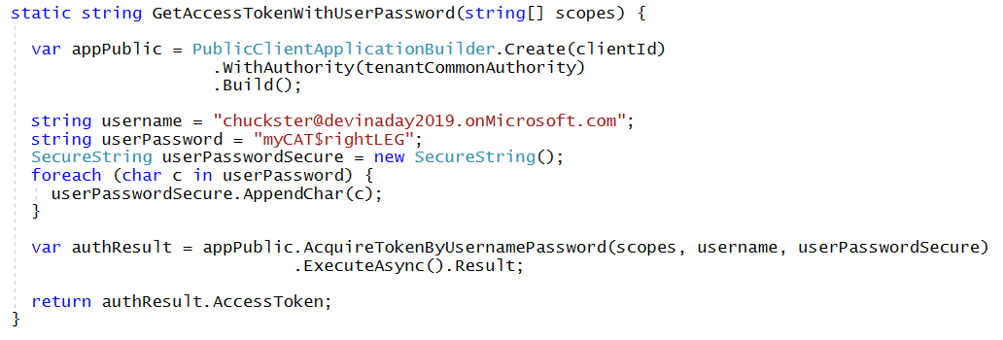
User Credential Password Flow
MSAL supports user credential password flow
Authentication performed by passing user password across the network
Microsoft recommends against using this flow in production scenarios

Slide 44
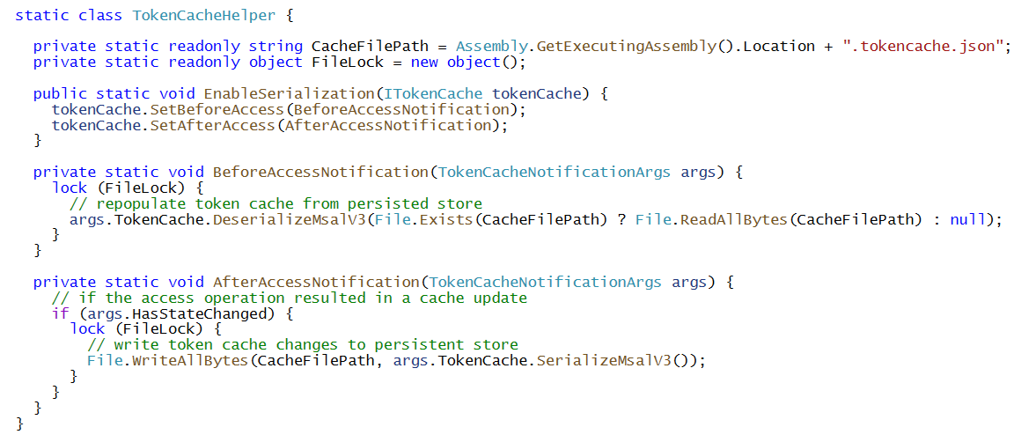
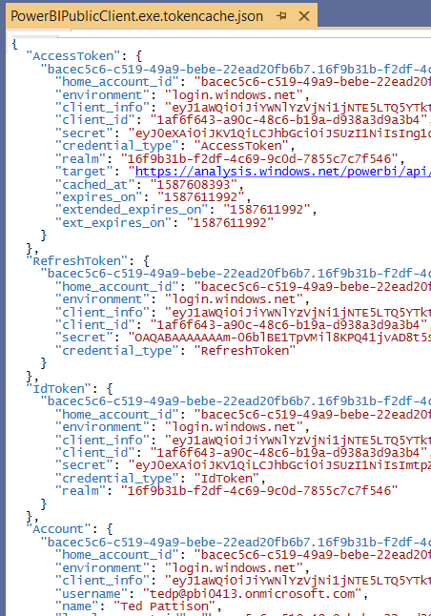
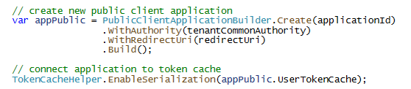
Token Caching for Public Client with MSAL
Create a Token Cache Helper class
Enable token cache for application

Slide 45
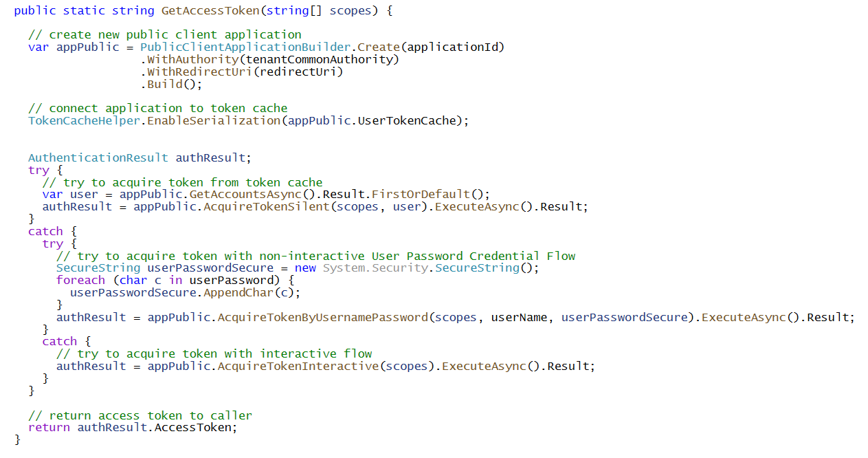
Acquiring Access Token from the Token Cache

Slide 46
Agenda
OAuth 2.0 and OpenID Connect
Microsoft Identity Platform 2.0
Developing with the Power BI .NET SDK
Developing with the App-Owns-Data Model
Developing Single Page Applications (SPAs)
Developing Secure Web Applications

Slide 47
What Is the Power BI Service API?
What is the Power BI Service API?
API built on OAuth2, OpenID Connect, REST and ODATA
API secured by Azure Active Directory (AAD)
API to program with workspaces, datasets, reports & dashboards
API also often called “Power BI REST API”
What can you do with the Power BI Service API?
Publish PBIX project files
Update connection details and datasource credentials
Create workspaces and clone content across workspaces
Embed Power BI reports and dashboards tiles in web pages
Create streaming datasets in order to build real-time dashboards

Slide 48
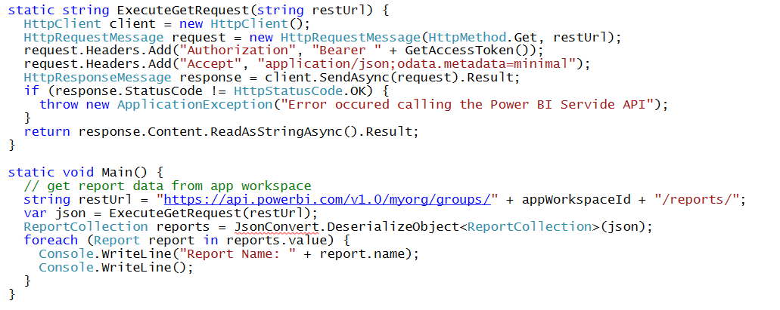
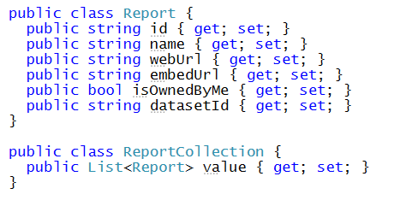
Calling the Power BI Service API Direct REST calls without using the Power BI .NET SDK
Your C# Code
Power BI
Service API
Executing HTTP Requests
Capturing HTTP Responses
Serializing/Deserializing JSON

Slide 49
Power BI .NET SDK
Developing without the Power BI .NET SDK
Developing with the Power BI .NET SDK
Your C# Code
Power BI
Service API
Executing HTTP Requests
Capturing HTTP Responses
Serializing/Deserializing JSON
Your C# Code
Power BI
Service API
Power BI .NET SDK
Executing HTTP Requests
Capturing HTTP Responses
Serializing/Deserializing JSON

Slide 50

Migrating to v3 of the Power BI .NET SDK
You must move to SDK v3 to take advantage of latest API features
Automated server-side generation of PDF file from Power BI report
Advanced generation of embed tokens
Beware of breaking changes when moving from v2.x to 3.x
Namespace Microsoft.PowerBI.Api.v2 renamed to Microsoft.PowerBI.Api
Namespace Microsoft.PowerBI.Api.Models.v2 renamed to Microsoft.PowerBI.Api.Models
Parameters for Power BI resource IDs now based on GUIDs instead of strings

Slide 51
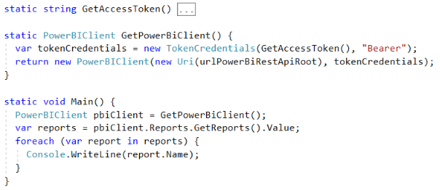
Initializing an Instance of PowerBIClient
PowerBIClient object serves as top-level object
Used to execute calls against Power BI Service
Initialized with function to retrieve AAD access token

Slide 52
User APIs versus Admin APIs
Power BI User APIs (e.g. GetGroupsAsync)
provides users with access to personal workspace
provides users with access to app workspaces
provides service principal (SP) with access to app workspaces
Power BI Admin APIs (e.g. GetGroupsAsAdminAsync)
provides users with tenant-level access to all workspaces
does not currently support app-only authentication

Slide 53
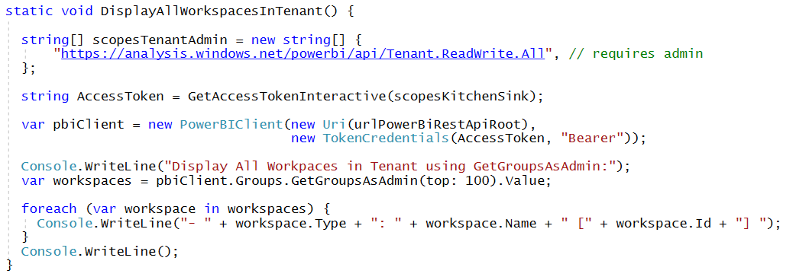
Calling into the Power BI Admin API
Admin API exposed using AsAdmin methods
Example:
Makes it possible to access every workspace in current tenant
Requires access token for user who is tenant or Power BI admin
Not supported when calling as service principal with app-only token

Slide 54
Agenda
OAuth 2.0 and OpenID Connect
Microsoft Identity Platform 2.0
Developing with the Power BI .NET SDK
Developing with the App-Owns-Data Model
Developing Single Page Applications (SPAs)
Developing Secure Web Applications

Slide 55
App-only Access Control
Service Principal used to configure access control
Requires the use of v2 app workspaces
Service principal must be added to app workspaces as admin or member
Access control NOT based on Azure AD permissions
App Workspace 1
Admins
User 1
User 2
App 1 Service Principal
Power BI Service
App 1 Service Principal
App-only Access Token
App Workspace 2
Admins
User 1
App 1 Service Principal
App 2 Service Principal

Slide 56
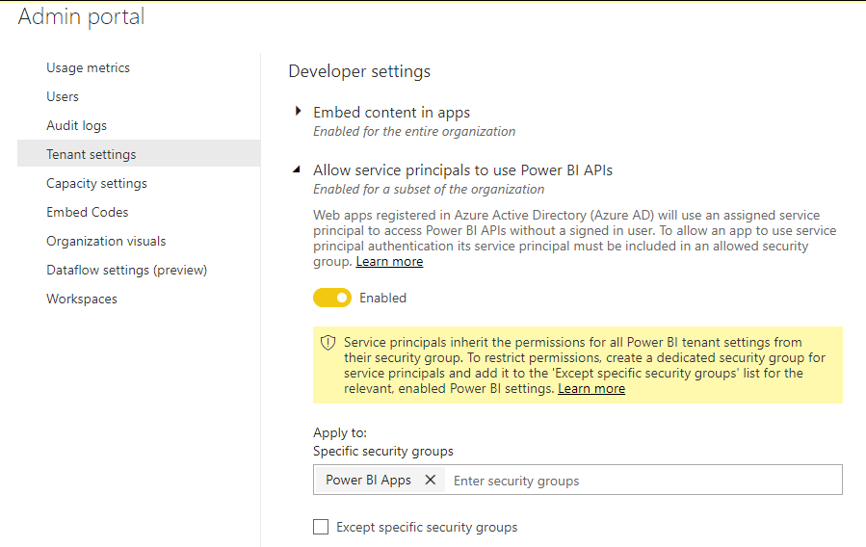
Tenant Setup
Your Power BI Tenant
These serviced principals now have access to the User APIs
Power BI Enabled
Service Principals
Service Principal
Application 1
Security Group
Power BI Apps
Service Principal
Application 2
Service Principal
Application 3

Slide 57
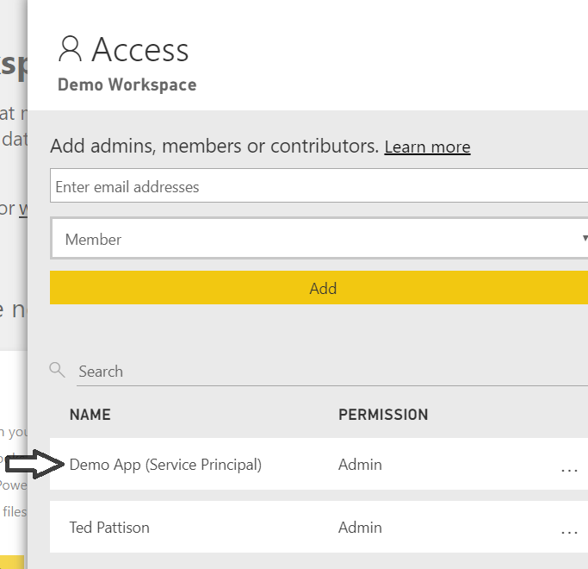
App-only Access with PBI Service API
Service Principal added to workspace as admin
Only works with v2 app workspaces
Provides full workspace access to service principal
App Workspace 1
Admins
User 1
User 2
App 1 Service Principal
App Workspace 2
Admins
User 1
App 1 Service Principal
App 2 Service Principal

Slide 58
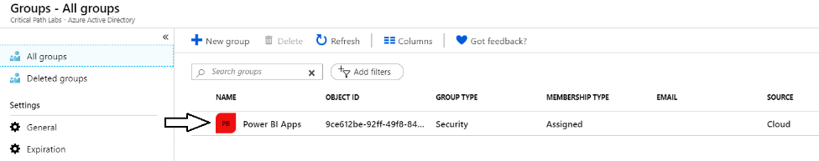
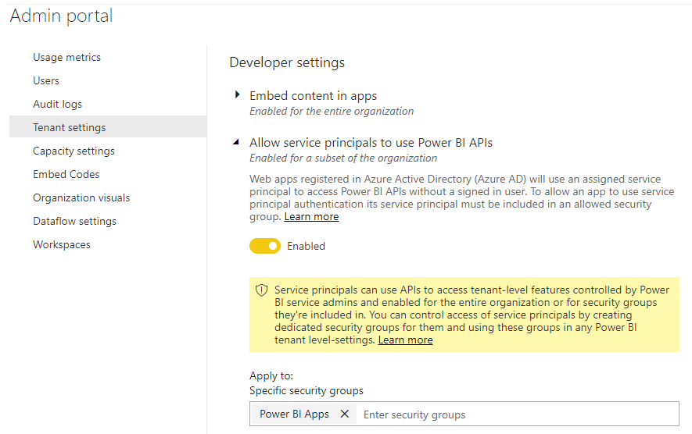
Setting Up for App-Owns-Data – Part 1
Enable Service Principal Access to Power BI Service API
Create an Azure AD security group (e.g. Power BI Apps)
Add group to Power BI Allow service principals to use Power BI APIs

Slide 59
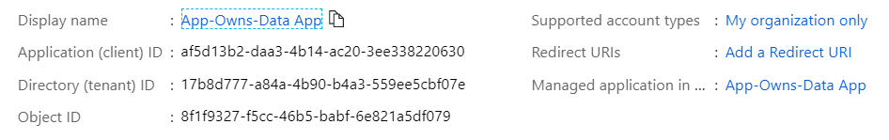
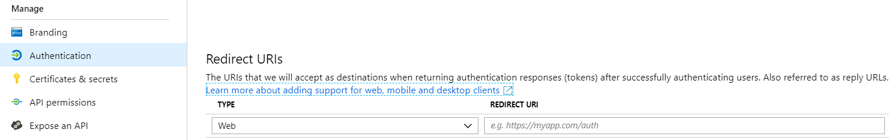
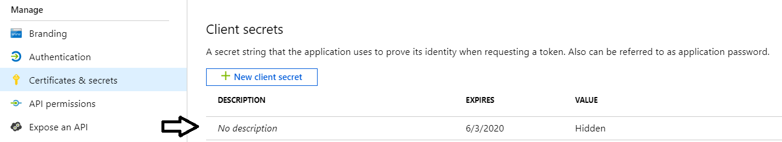
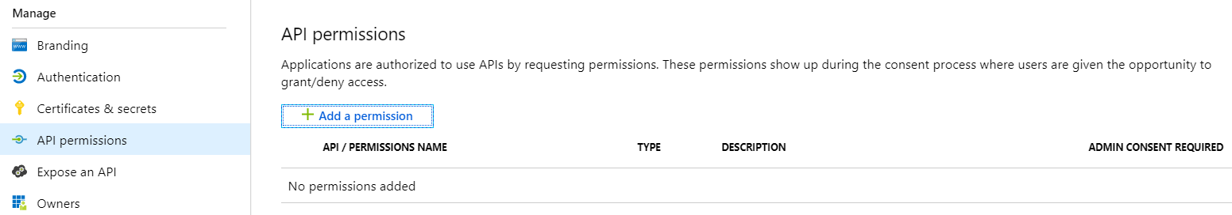
Setting Up for App-Owns-Data – Part 2
Create a confidential client in your Azure AD tenant
Configured as TYPE=Web and no need for a redirect URL
Add a client secret or a client certificate
No need to configure any permissions

Slide 60
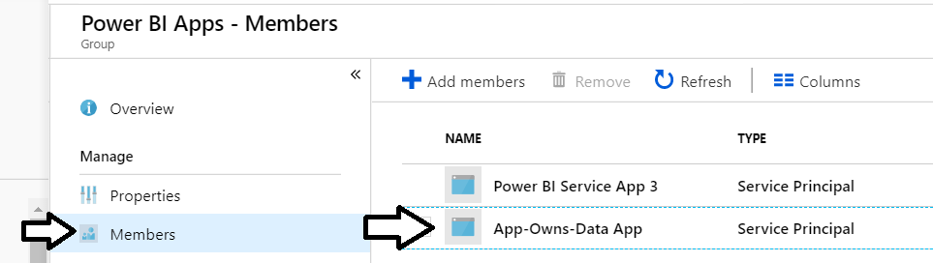
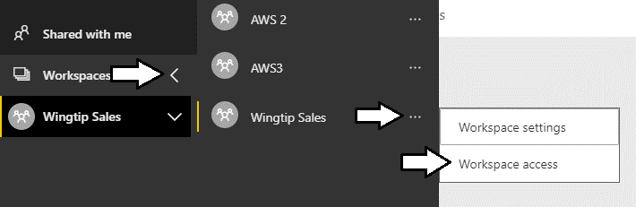
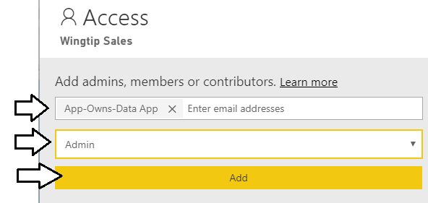
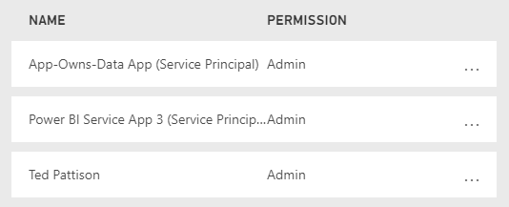
Setting Up for App-Owns-Data – Part 3
Add application's service principal in Power BI Apps security group
Configure application's service principal as workspace admin
Service principal should now be workspace admin

Slide 61
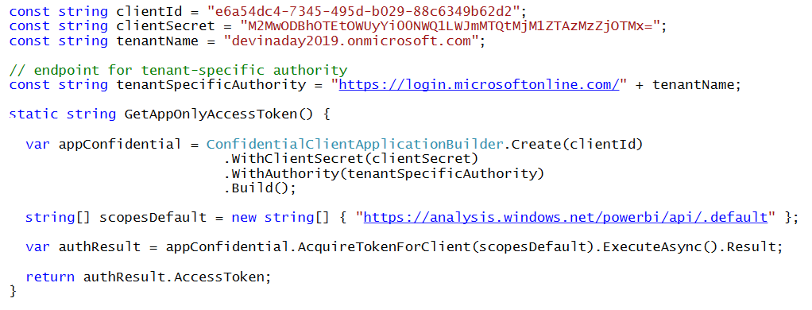
Client Credentials Flow
Client credentials flow used to obtain app-only token
Requires passing app secret (e.g. app password or certificate)
Requires passing tenant-specific endpoint

Slide 62
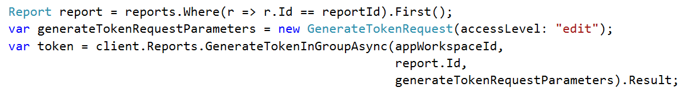
Generating Embed Tokens
You can embed reports using an AAD token, but…
You might want embed resource using more restricted tokens
You might want stay within the bounds of Power BI licensing terms
You generate embed tokens with the Power BI Service API
Each embed token created for one specific resource
Embed token provides restrictions on whether user can view or edit
Embed token can only be generated in dedicated capacity (semi-enforced)
Embed token can be generated to support row-level security (RLS)

Slide 63
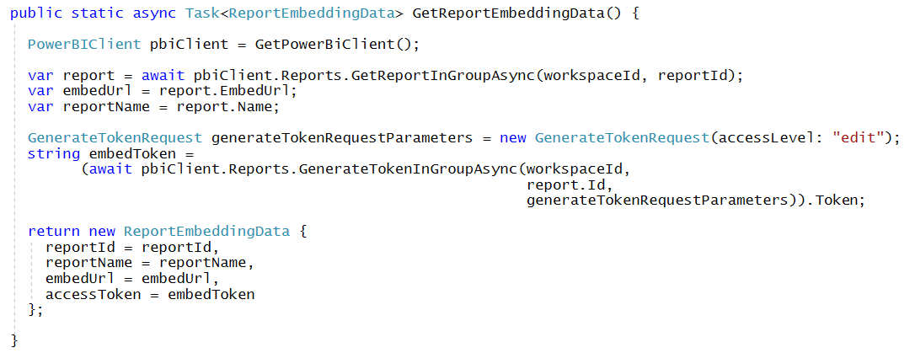
Getting the Data for Report Embedding

Slide 64
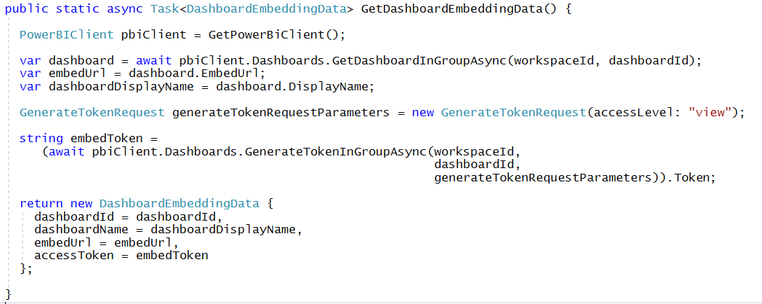
Getting the Data for Dashboard Embedding

Slide 65

Getting Data for New Report Embedding

Slide 66
Agenda
OAuth 2.0 and OpenID Connect
Microsoft Identity Platform 2.0
Developing with the Power BI .NET SDK
Developing with the App-Owns-Data Model
Developing Single Page Applications (SPAs)
Developing Secure Web Applications

Slide 67
Understanding Implicit Flow
Used in single page applications (SPAs)
All code and configuration loaded into client-side browser
Application runs as web application at verifiable URL on the Internet
SPA must be running at URL registered as a redirect URL
Application isn't really confidential - it cannot keep any secret
Implicit flow involves passing access token directly to browser
Passing access token to browser isn't ideal - but it's tolerated when developing SPAs
MSAL provides a version of JavaScript/TypeScript Developers
There are node.js packages and NuGet packages for msal.js

Slide 68
Agenda
OAuth 2.0 and OpenID Connect
Microsoft Identity Platform 2.0
Developing with the Power BI .NET SDK
Developing with the App-Owns-Data Model
Developing Single Page Applications (SPAs)
Developing Secure Web Applications

Slide 69



Open Web Interfaces for NET (OWIN)
OWIN interfaces decouple web server from application
OWIN serves to decouple .NET applications from Windows and IIS
OWIN promotes the development of smaller modules (middleware)
Microsoft's Implementation known as Katana
Makes it possible to use OWIN with ASP/NET and ASP Core
Microsoft provides OWIN-based security middleware
Your Web Application
Katana (OWIN implementation for ASP.NET)
OWIN
Web Server and OS

Slide 70
OWIN Middleware Modules
OWIN create pipeline of middleware components
Middleware components added to pipeline on application startup
Middleware components pre-process and post process requests
Middleware components commonly used to set up authentication
OWIN Middleware Pipeline
Browser
Middleware
Component 1
Middleware
Component 2
Web
Application
request
response

Slide 71
Authorization Code Grant Flow
Sequence of Requests in Authorization Code Grant Flow
Application redirects to AAD authorization endpoint
User prompted to sign in using Windows logon page
User prompted to consent to permissions (first access)
AAD redirects to application with authorization code
Application calls to AAD token endpoint to acquire access token
Request authorization code
Sign-in via browser pop-up
Return authorization code
Pass authorization code to acquire access token for Power BI Service resource
Return access token and refresh token
Call Power BI Service API using the access token
Return Http Response
Authorization Endpoint
Token Endpoint
Client Application
Power BI Service API

Slide 72
OWIN OpenID Connect Module
OpenID Connect module used to implement Authorization Code Flow
Redirects browsers to authorization endpoint
Provides notification when receiving authorization code callback
OWIN Middleware Pipeline
Browser
OWIN
Security
Cookies
OWIN OpenID Connect
Web
Application
request
response

Slide 73

Token Caching and Refresh Tokens
OAuth 2.0 provide solution for access token expiration
Access tokens have default lifetime of 60 minutes
Authorization server passes refresh token along with access token
Refresh token used as a credential to redeem new access token
Refresh token default lifetime is 14 days (max 90 days)
Refresh tokens often persistent in database or browser storage
MSAL offers built-in support to manage token caching

Slide 74
Summarization of Authentication Flows
Public clients
Interactive Flow
User Password Credential Flow
Confidential web clients
Client Credentials Flow
Implicit Flow
Authorization Code Flow

Slide 75
Summarizing Power BI Authentication Patterns
User-Owns-Data Embedding
App authenticates as current user
Use implicit flow for SPAs
Use auth code for better security
User’s access token passed to browser
Row-level security (RLS) works as expected
App-Owns-Data Embedding
App authenticates with app-only identity
Use client credentials flow
Service principle must be workspace member
Embed token passed to browser
EffectiveIdentity used with RLS
User-Owns-Data Embedding for use within Organization
App-Owns-Data Embedding for use by ISVs
Browser
Power BI Service
Browser
Power BI Service
iFrame
iFrame
Azure AD
Access Token
Power BI
Embed Token

Slide 76
Summary
OAuth 2.0 and OpenID Connect
Microsoft Identity Platform 2.0
Developing with the Power BI .NET SDK
Developing with the App-Owns-Data Model
Developing Single Page Applications (SPAs)
Developing Secure Web Applications

Slide 77
Questions

